Slide 1
Zero Downtime Deployments & CI/CD
Nick Althoff
Cloud Solution Architect
3Cloud

Slide 2

Today’s Discussion
Azure Web Apps
DEMO - Azure Web Apps
Visual Studio Deployment
Automated Build to Azure Web App
Deployment Slots
DEMO – Using Deployment Slots
Containers
DEMO
Dockerizing an app
CI/CD with Docker

Slide 3

Who is this guy?
Nick Althoff
Cloud Architect - 3Cloud
nalthoff@3cloudsolutions.com

Slide 4



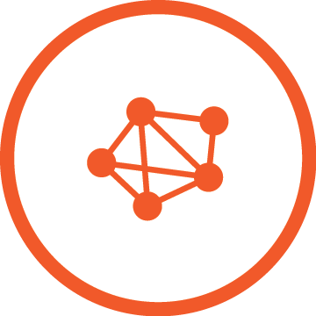


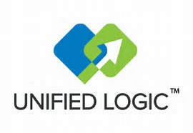
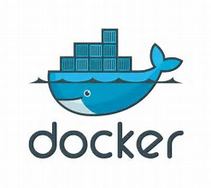
3Cloud Practices and Solution Focus
DIGITAL TRANSFORMATION
Tier 2 Partner
(formerly NSI)
Other Key Partnerships
Cloud Infrastructure Services & Operations
DevOps &
Optimizations
Cloud Application
Development
Data Services &
Advanced Analytics
Practice
Practice Director
Matt Kestian
Rob Wenc
Rob Wenc
Jake Kremer
Data Center Migration
Advanced Monitoring and Management
Virtual Networking
Cloud Readiness Assess
Data Center Migration
Cloud Security, Compliance
Software Defined Network
Cloud Management & Ops
Build Pipelines
Azure Automate/Optimize
Containers/ Docker
Orchestration/ K8s, Swarm
Application Assessment
Application Modernization
DevOps Inception, Elaboration, Implement.
Docker Days with PoC and Implementation
Cloud Native App Develop
Microservices
Develop Modernization
Web, Mobile, API Services
Application Assessment
Application Modernization
App Dev Inception, Elaboration, Implement.
Mobile, Web, API Dev & Implementation
Data Visualization – Power BI, SSRS
Big Data – Cortana Analytics and Azure Machine Learning
Data Readiness Assessment
Analytics Proof of Value
Azure SQL Ready
Modern Data Platform (SQL and noSQL)
Solution Scenarios
Offerings
BUSINESS ADVISORY, AZURE ACQUISITION & MANAGED SERVICES

Slide 5
Application landscape
~2000
Today
Loosely Coupled Services
Monolithic
Rapidly updated
Slow changing
Many Small Servers or devices
Big Servers
5

Slide 6
Challenges between developers and IT
Developers |  | IT
I need to create applications at a competitive rate without worrying about IT. |  | I need to manage servers and maintain compliance with little disruption.
New applications run smoothly on my machines but malfunction on traditional IT server. |  | I’m unsure of how to integrate unfamiliar applications, and I require help from developers.
My productivity and application innovation become suspended when I have to wait on IT. |  | I’m unable to focus on both server protection and application compliance.

Slide 7


Azure App Service
Quickly build powerful web, mobile, and API apps using .NET, .NET Core, Java, Ruby, Node.js, PHP, and Python
Fully Managed platform on Windows Or Linux
Scale up or out automatically
Host your apps anywhere in Microsoft's global datacenter infrastructure
Automated Deployments with continuous CI/CD capabilities
Azure equivalent to AWS “Elastic Beanstalk”

Slide 8
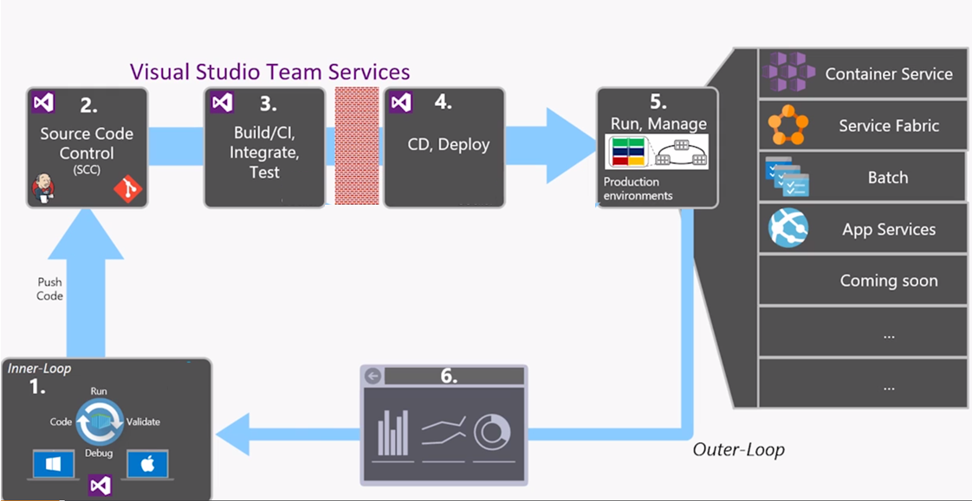
CI / CD Process

Slide 9
Demo
Azure Web Apps

Slide 10
Deployment Slots
When you deploy your web app, you can deploy to a separate deployment slot instead of the default production slot
Deployment slots are actually live apps with their own hostnames
App content and configurations elements can be swapped between two deployment slots

Slide 11
Deployment Slot Benefits
You can validate app changes in a staging deployment slot before swapping it with the production slot.
Deploying an app to a slot first and swapping it into production ensures that all instances of the slot are warmed up before being swapped into production, eliminating downtime
Changes swapped into the production slot are not as you expected, you can perform the same swap immediately to get your "last known good site" back

Slide 12
Demo
Automated Deployments w/ Deployment Slots

Slide 13
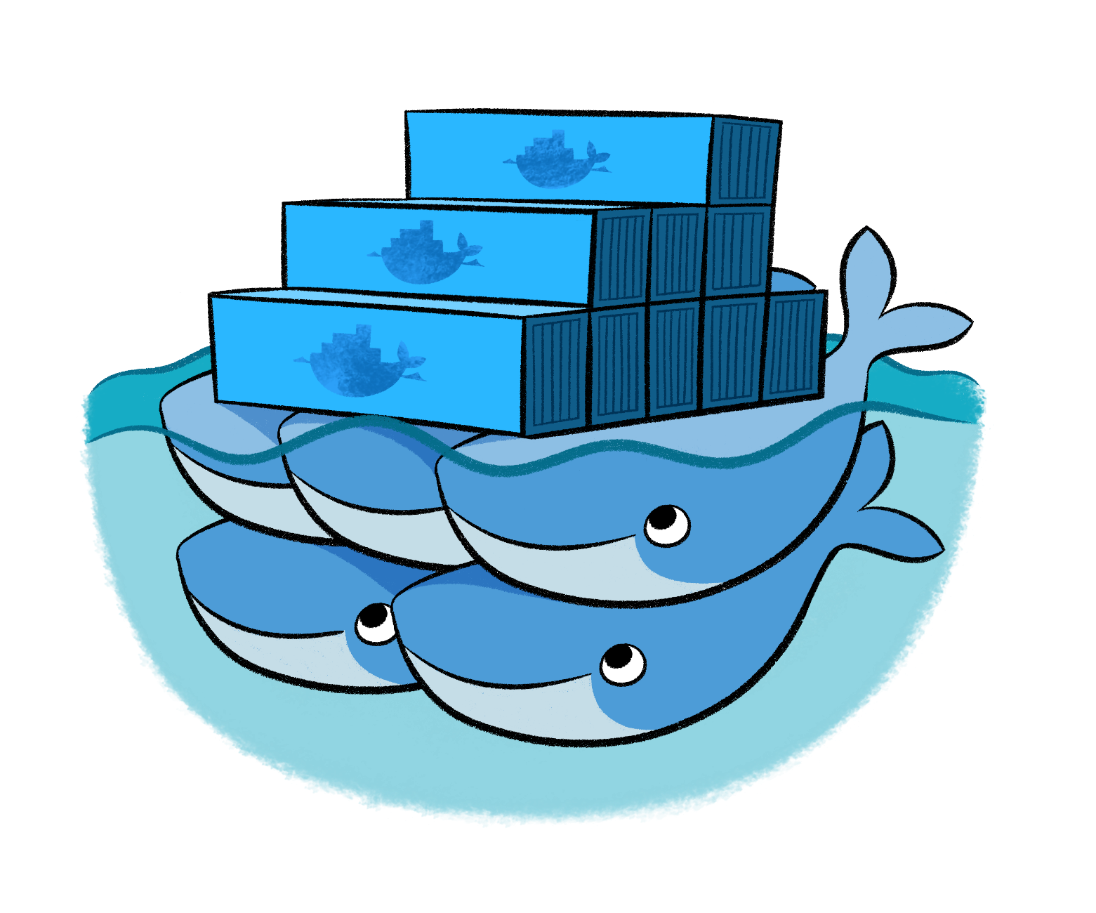
Docker
What is Docker?
Docker is an open-source project that automates the deployment of applications inside software containers, by providing an additional layer of abstraction and automation of operating system–level virtualization on Linux and Windows.

Slide 14
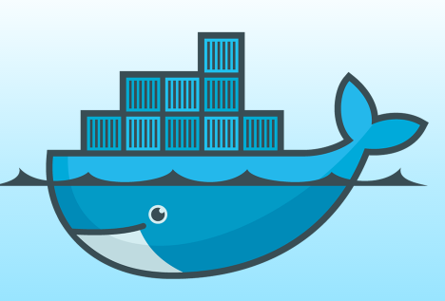
Docker
Docker == Container
There are other container technologies, but the most popular is Docker. The technology is open source and has been around for over a decade.
Docker also refers to the company that provides Docker support and resources.
[www.docker.com]

Slide 15
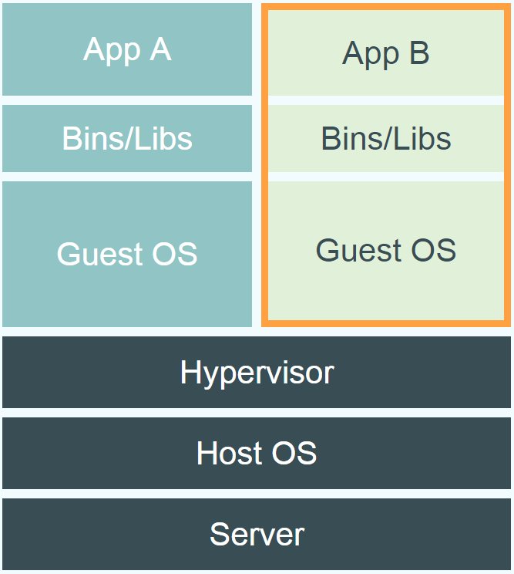
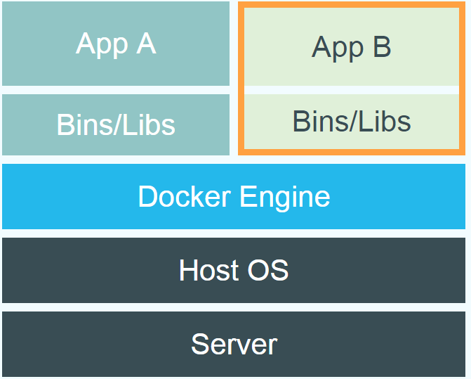
Containers vs Virtual Machines
Containers
VM

Slide 16
Docker Components
Dockerfile
File containing commands to build an image
Typically start with an existing image and add additional customizations
Code analogy: “Compiler”
Image:
Build via DockerFile
Persisted Snapshot that can be run
Contains “set up” commands such as adding dependencies, installing features
Code Analogy: “Class Definition”
Container:
Running instance of an Image
Code Analogy: “Instance of a class”

Slide 17
Docker Hub
Image Repository where you can find and pull images from community and official libraries
Examples of available Microsoft Images:
Microsoft/WindowsServerCore
Headless image of Windows Server 2016
Microsoft/ASPNET
Windows Server Core w/ IIS 10, .NET Framework already installed
Microsoft/IIS
Windows Server Core or NanoServer w/ IIS 10 installed
Microsoft/aspnetcore
Linux or Windows based with .NET Core Runtime installed.
Microsoft/mssql-server-windows
Windows based SQL Server
Also available in Linux

Slide 18
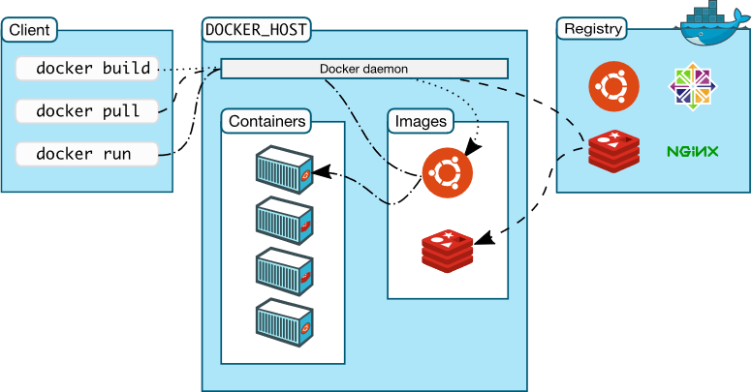
Docker Architecture

Slide 19
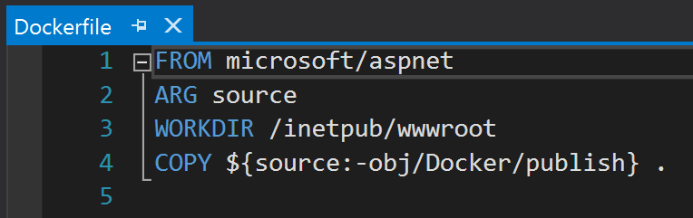
How to containerize an application
Step 1
Create Dockerfile
Step 3
Run the app in docker
Build Image
Step 2
docker build .
docker run mynewimage

Slide 20
Demo
Dockerize an existing App

Slide 21
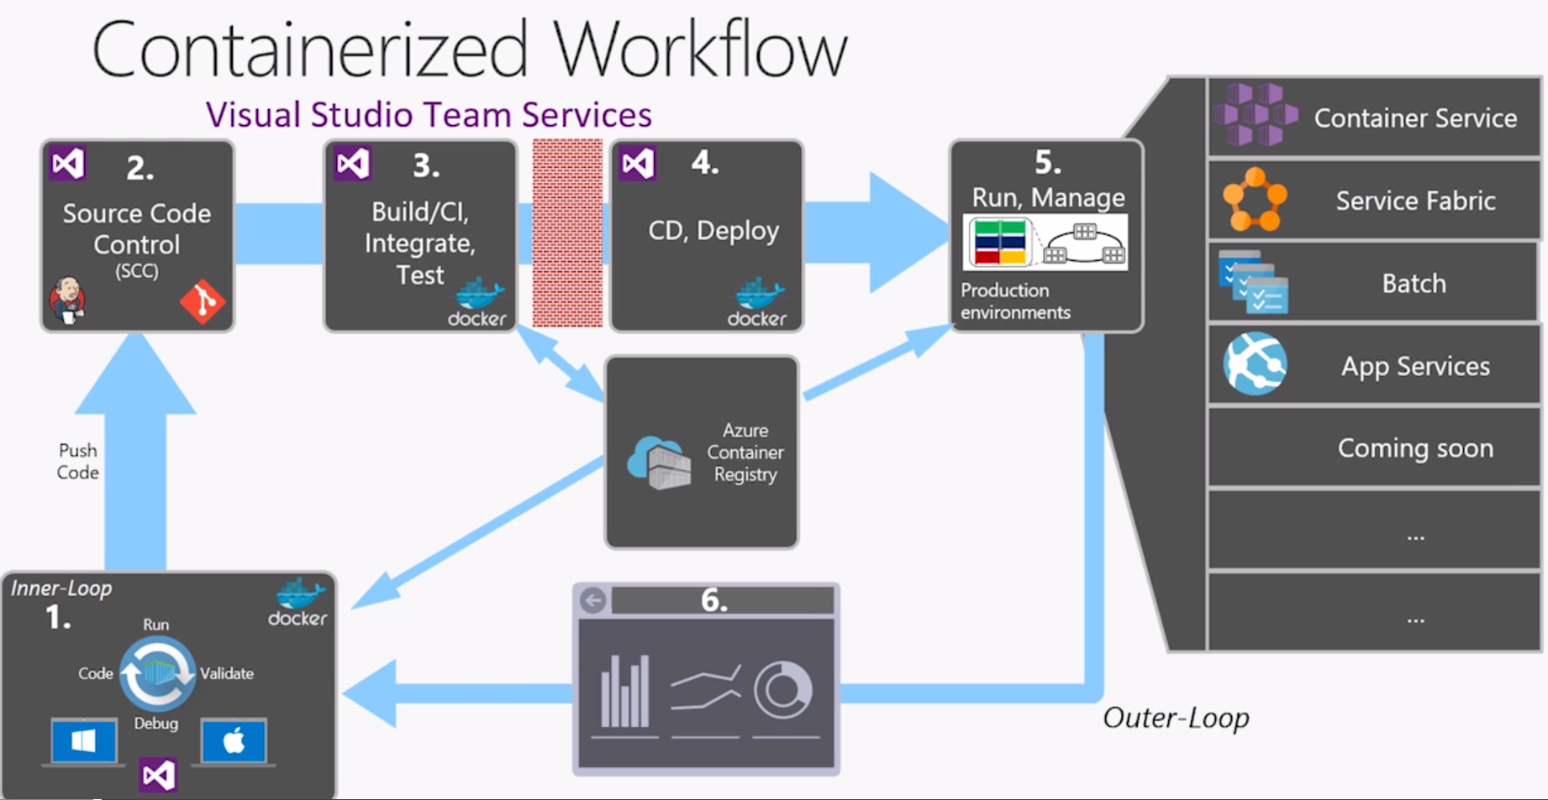
Build Pipelines w/ Docker

Slide 22
Blue / Green Deployments in Kubernetes
Zero downtime deployments are “Built in” to Kubernetes
New Containers(pods) are started up while old containers are left running, then the DNS is switched from old containers to new containers with no downtime

Slide 23
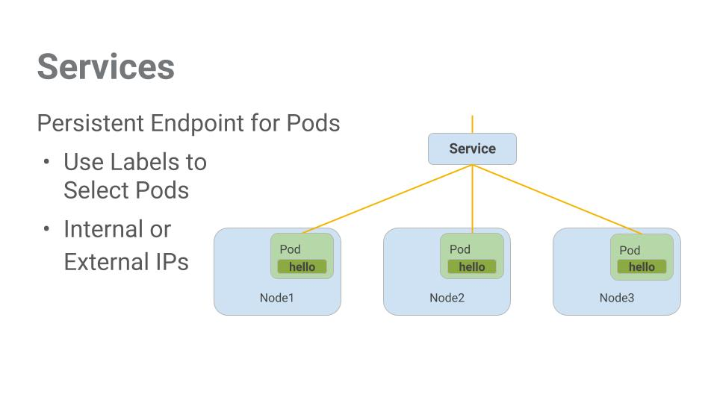
Services / Nodes / Pods / Containers

Slide 24
Demo
CI/CD with Docker

Slide 25
Hands on Lap
Create your own CI/CD Pipeline in Azure
Follow instructions here:
https://github.com/nalthoff/ZeroDowntime

Slide 26
THANK YOU!
Nick Althoff
Cloud Architect - 3Cloud
nalthoff@3cloudsolutions.com

